Slide 1


Computer Scientists Retrieval
Luca Tomei
Daniele Iacomini
Andrea Aurizi

Slide 2
Reference Paper: Ranking Guitarists
Apply Google PageRank to Wikipedia guitarists articles to rank them based on inﬂuence they had on each other
Key Points:
1) Collecting data about guitarists and their inﬂuences from Wikipedia;
2) Converting this data into a directed graph, where a node represents a guitarist, and an edge from A to B represents the inﬂuence from A to B;
3) Applying Google PageRank algorithm to rank the guitarists.
Goals:
1) Using a quantitative method to ﬁnd the most inﬂuential guitarist
2) Estimation of inﬂuence from the guitarist community itself, instead of fans

Slide 3
Our Approach: Computer Scientists Retrieval
Replicate the paper by finding the most influential computer scientists
Dataset is computed by SPARQL queries, to retrieve computer scientist influenced and influencers, and by scraping the Wikipedia pages of each computer scientist
Results are computed using two different methods:
Blind meta-data link picking
“Influences” section analysis

Slide 4
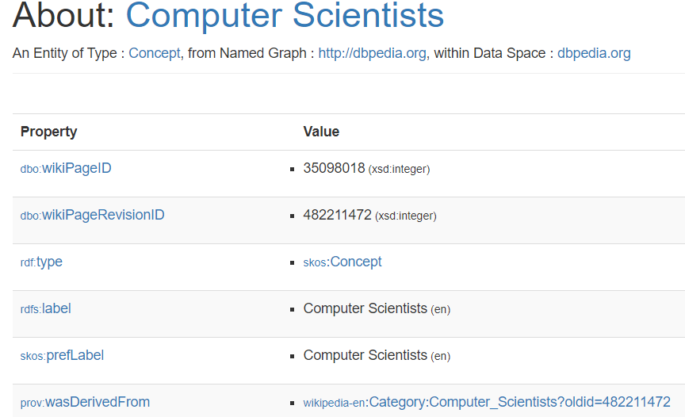
Dataset construction - DBPedia
Retrieve all the computer scientists from DBPedia
SPARQL queries
Lists of computer scientist
As the figure above shows, DBPedia does not retrieve results for computer scientists, because there is no dataset on them. In DBPedia the majority of computer scientists is assigned to a generic class dbpedia:Person and not distinguished from other people.
Few results
DBPedia returns to the Wikipedia page

Slide 5
01
02
03
04
Manual scraping of Wikipedia data
Collect all C.S. Links
Check biography table
Computing Pagerank
C.S. Fields Classification
Collect in a file all the links of computer scientists present on Wikipedia
Check whether the relative page contains information about his influences
Quantify the importance of computer scientists
Classification of the various fields of study of a computer scientist

Slide 6
Dataset construction - Wikipedia
Lists of computer scientists
Retrieve all the computer scientists from Wikipedia
Associate each computer scientist in order to consider his influences
Download each Wikipedia page associated to each computer scientist
Python scripts are being used in order to provide the lists and download the pages, resulting in 509 different computer scientist.
Retrieve Computer Scientists Wikipedia pages
Applying Google PageRank algorithm to rank computer scientists.
Computer Scientist branches classification

Slide 7


Methods used
Blind meta-data link picking
Consider link structure between Wikipedia pages of computer scientists to build directed graph
Hypothesis: if there exists a link from page of computer scientist $s_{1}$ to page of computer scientist $s_{2}$ then $s_{1}$ was influenced by $s_{2}$
“Influences” section analysis
Scraping of Wikipedia computer scientists’ pages to get “influences” section
Hypothesis: if computer scientist $s_{2}$ is mentioned in the “influence” section of computer scientist $s_{1}$ then $s_{1}$ was influenced by $s_{2}$

Slide 8
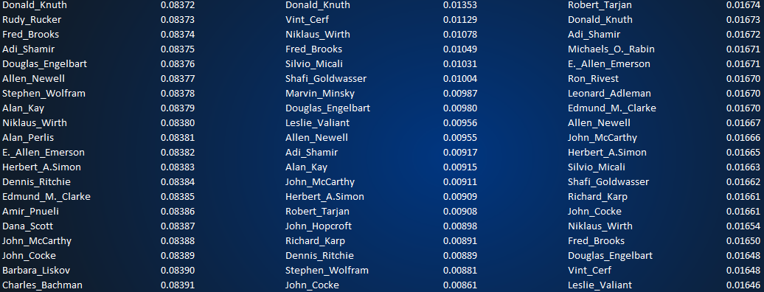
Applying personalized Pagerank
Personalized Pagerank
NetworkX Pagerank
NetworkX HITS

Slide 9
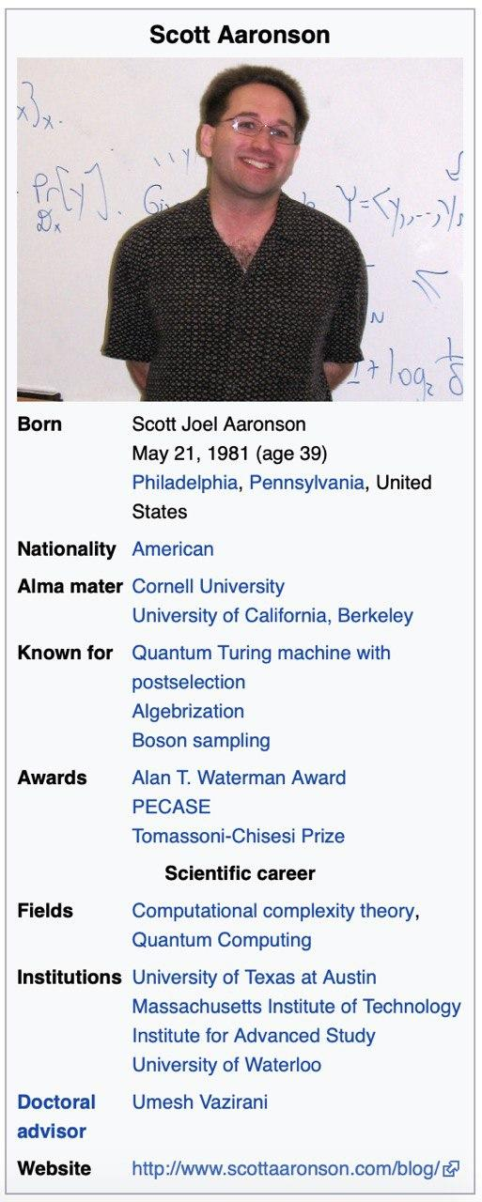
Computer Scientists’ branches
A further experiment was to try to draw up a ranking of the best branches of study carried out by these people.
In evaluating the fields that can be used, it has been verified that the majority of computer scientists present in the famous Wikipedia infobox table a field called Field which is right for us: it contains every category of study carried out from the person being examined.

Slide 10
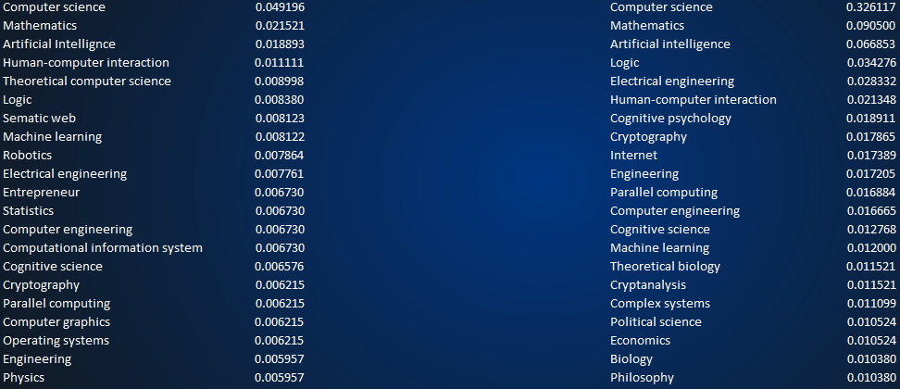
Applying Pagerank and HITS on branches
Compare the results given by the PageRank algorithm with other qualitative methods
NetworkX Python library + HITS algorithm

Slide 11
Conclusions
Successful appliance of procedures descripted in the original paper to computer scientists
The discrepancy between the rankings is minimal
Major difficulty in the experiment: polishing the data in order to provide reliable results
Complete rankings in the Github page OUR GITHUB REPOSITORY

Slide 12
Thanks!
Luca Tomei
Daniele Iacomini
Andrea Aurizi

